Slide 1
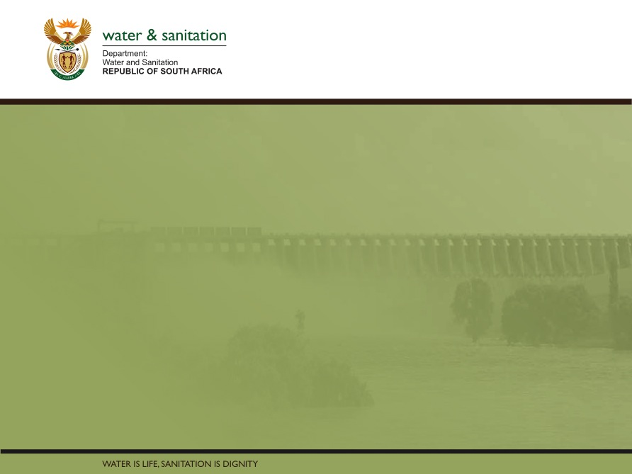
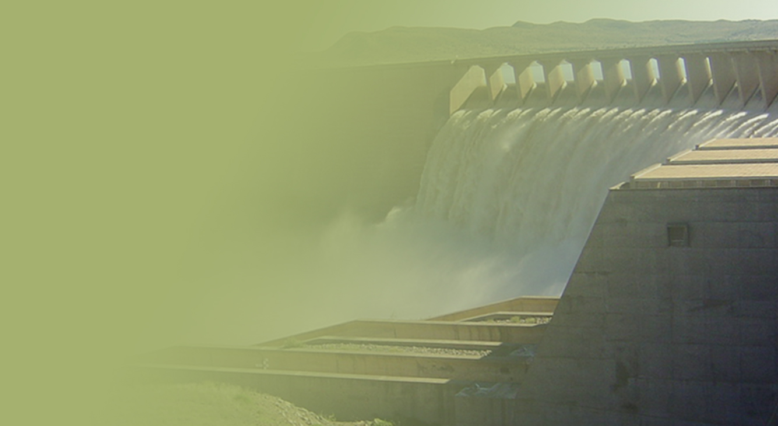
Determination of Water Resource Classes & Associated Resource Quality Objectives (RQOs) in the Mzimvubu Catchment
Presented by:
Lawrence Mulangaphuma
Department of Water & Sanitation
Date: 05-06 June 2018
PRESENTATION TITLE
Presented by:
Name Surname
Directorate
Date

Slide 2
Presentation Content
  Study Area
  Legal Mandate
  Resource Directed Measures
  Process for the determination of Water Resources classes and Resource Quality Objectives
  Stakeholder Engagement Plan
  Purpose of Public meeting

Slide 3
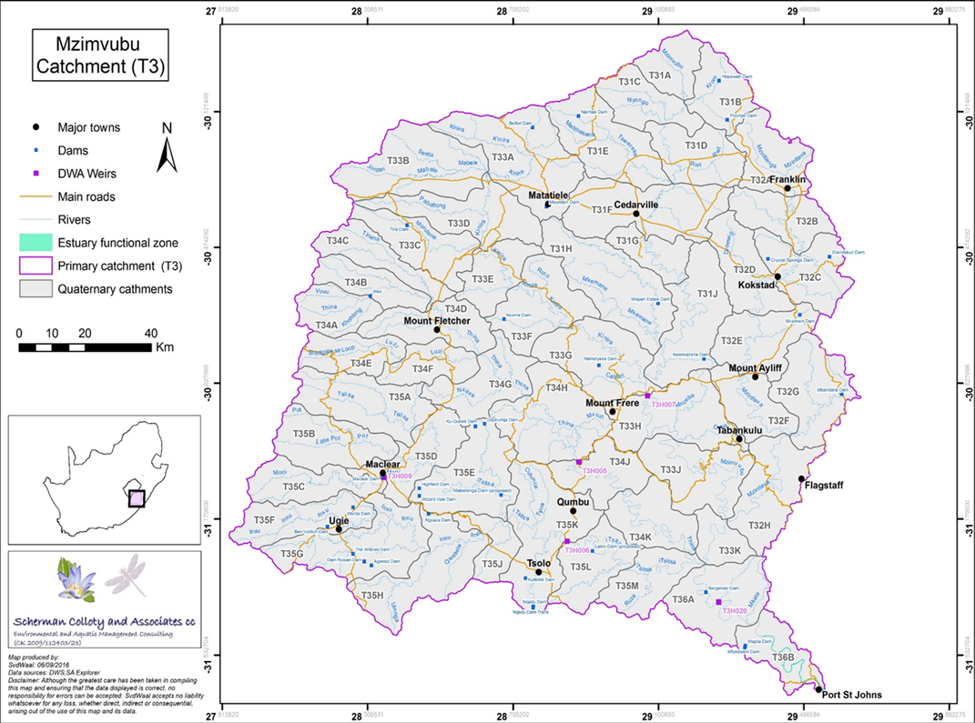
Study area

Slide 4
Legal Mandate
Chapter 3 of the National Water Act (No. 36 of 1998), deals with the protection of water resources
The measures for protection of water resources are:
  Classification (S13)
  Reserve (S16)
  Resource Quality Objectives (S13)
S12 requires the Minister to establish the Water Resource Classification System, (WRCS)
WRCS was published as Regulation 810 in Government Gazette No. 33541 dated 17 September 2010
The WRCS defines:
  water resource classes and
  the procedure to determine Class, RQOs and Reserve
According to the NWA, once the WRCS has been gazetted all significant water resources must be classified and Resource Quality Objectives determined

Slide 5
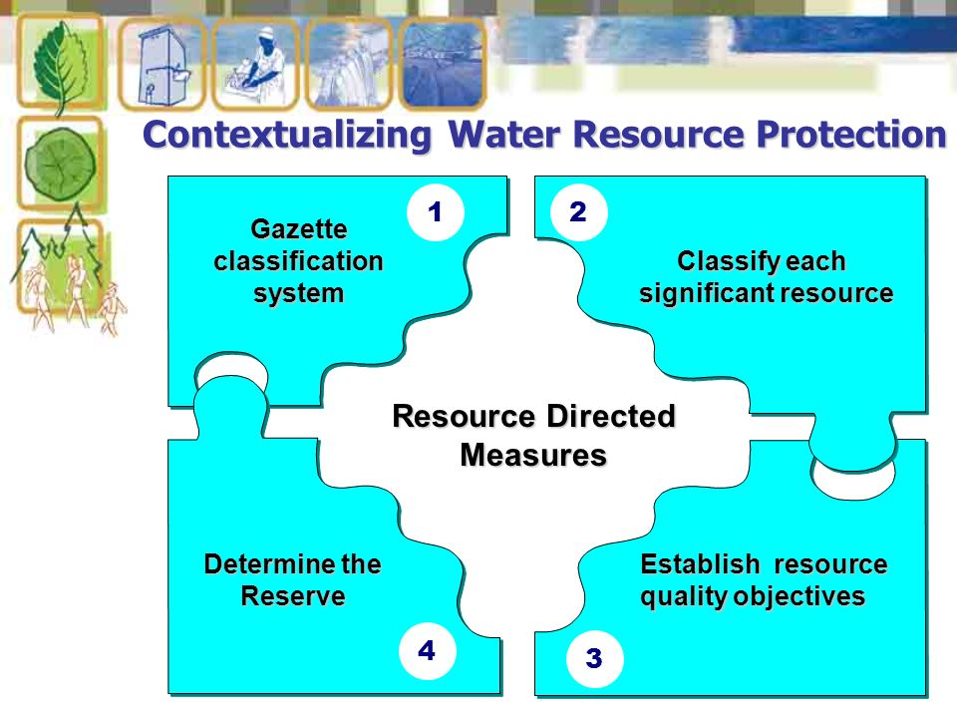
Contextualizing Resource Directed Measures

Slide 7
STEP 1: Delineate the units of analysis and describe the status quo of the water resources
By ‘units of analysis’ we mean the spatial units that will be defined as significant resources
The catchment status quo refers to the current condition of the significant resources (i.e. current socio-economic status, water use allocations and status of the water resource infrastructure).
OUTCOME:
Defined set of IUAs for a target catchment;
List of the nested biophysical and allocation nodes within each IUA

Slide 8
STEP 2: Link the value and condition of the water resource
The present-day value of the aquatic water use and sectoral water use is quantified.
These steps therefore define a ‘value baseline’ against which changes in value can be assessed for different scenarios of water resource class
OUTCOMES
A list of ecosystem values (ecological and socio-economic data available to estimate change)
Scoring system for the evaluation of scenarios in later steps of the classification procedure

Slide 9
STEP 3: Quantify the Ecological Water Requirements and changes in non-water quality Ecosystem Goods, Services and Attributes
The quantification of EWRs is part of the Reserve determination process, the determination of the Reserve is part of the Classification Process.
OUTCOMES
A list of nodes to which information can be extrapolated.
EWR rule curves, EWR summary tables and Modified time series for each category for each node.

Slide 10
STEP 4: Determine an Ecologically Sustainable Base Configuration (ESBC) scenario and establish the starter configuration scenarios
The ESBC scenario is defined as the lowest theoretical level of protection required for the sustainable use of the entire catchment.
The NWA stipulates that a resource should be managed to ensure that it may be used in an ecologically sustainable way.
Further, RDM policy states that this minimum level of health should be at least a D category condition
OUTCOMES
Hydrologically (water quality and quantity) and ecologically tested ESBC scenario that defines the lowest theoretical level of protection required.

Slide 11
STEP 5: Evaluate scenarios within the Integrated Water Resource Management
(IWRM) process
Evaluate scenarios within the integrated water resource management (IWRM) process so that a subset of catchment configuration scenarios can be put forward for stakeholder evaluation in Step 6.
OUTCOMES
Adjusted catchment configuration scenarios for input into next Step

Slide 12
STEP 6: Evaluate the scenarios with stakeholders
Evaluate the subset of scenarios selected in Step 5 together with the stakeholder scenarios, and to agree on an overall preferred catchment configuration scenario or a shortlist of scenarios for the Minister’s consideration in Step 7.
OUTCOMES
A short-list of final scenarios agreed-on and signed-off both by the relevant stakeholders and by DWS together with reasons for their selection.

Slide 13
STEP 7: Gazette the class configuration
Publish the class configurations and their associated RQOs in the Government Gazette as required by the NWA.
OUTCOMES
A populated gazette summary template presented to the Minister or his/her delegated authority.
The Minister deciding on IUA classes, nested ecological category configurations, Reserve(s), allocation schedule(s) and Catchment Management Strategy (CMS).

Slide 14
Outcome of Water Resource Classification process
Classification defines the desired state of the water resources by setting Water Resource Classes;
Each class represents:
    a different level of protection that is required for the water resource, and
    the extent to which the water resource can be used.
Classification is used in two ways:
    To describe the present status of the water resource
    To describe the state towards which the water resource needs to be managed sustainably (future state).
Surface water, groundwater, wetlands, estuaries
 | Description of use | Majority of ecological categories
Class I | Minimally used | A-B
Class II | Moderately used | C
Class III | Heavily used | D
Ecological Category (EC) - means the assigned ecological condition to a water resource . It is measured by determining how much the ecosystem has changed from natural (pre-development condition). The scale is A (near natural) to F (critically modified)
14

Slide 15
Resource Quality Objectives Process
  Purpose → “establish clear goals relating to the quality of the relevant water resources”
  In determining RQOs, “a balance must be sought between the need to protect and sustain water resources and the need to use them”
  Numerical and/or descriptive statements and may relate to quantity, quality, habitat and biota.
  Must take account of user requirements and the class of the resource
  Binding on all authorities and institutions
15

Slide 17
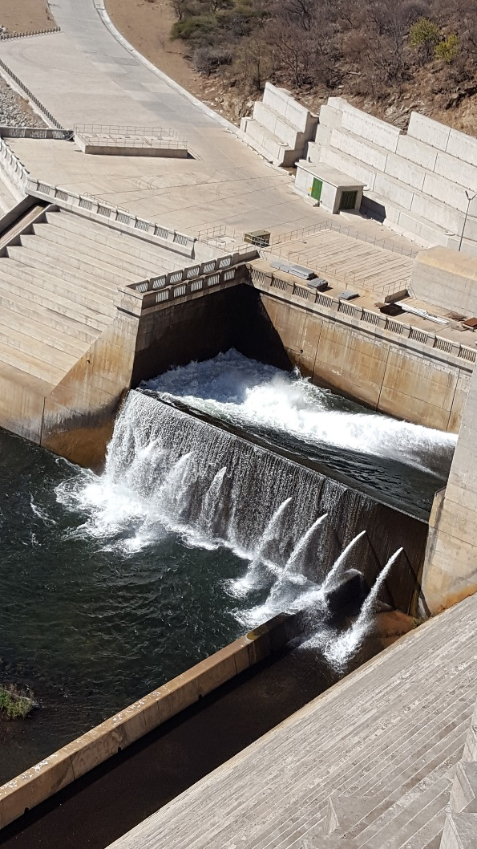

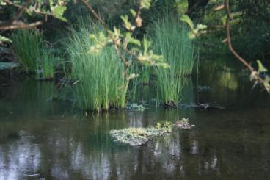
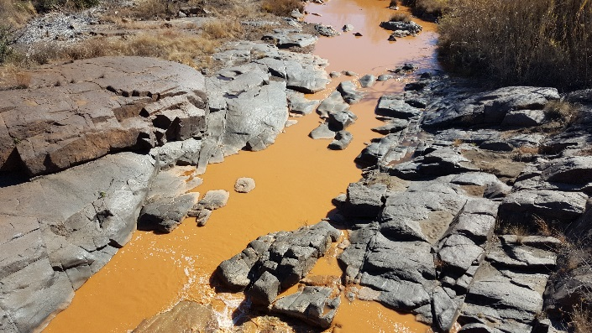


Resource Quality Objectives Outcome
The study should provide statements about:
    what the quantity of the water should be (water level, pattern, timing)
    what the water quality should be (physical, chemical and biological
    what the condition of the instream and riparian (river bank) habitat should be
    what the condition of the aquatic (water) animal and plant life should be.
Releases are looking good
This is perfect for me
HELP!!
17

Slide 18
Stakeholder Engagement Plan
Platforms | Stakeholder groups | Purpose
Project Steering Committee | Representatives from various Sectors | To give strategic inputs to the project PSC 1 (05/12/16), PSC 2 (18/07/2017), PSC 3 (13/02/2018) and PSC 4 (04 May 2018
Technical Task team Meeting | Representatives from sectors with technical knowledge of study area and water resource management | To source comments and inputs on technical aspects of the project TTG: WQ info was held on 31/01/17
Public Meetings | The broader public | To announce the project To present the proposed classes & RQOs (End of the project: 05 & 06 June 2018)
Forums | Catchment management forums | Information sharing UCPP held on 11/04/18
Sectors | Different sectors e.g. Domestic, Agriculture, mining etc. ( where necessary). | Information sharing

Slide 19
Purpose of the Public meeting
To provide an overview of the steps followed to determine the Water Resource Classes and Resource Quality Objectives for the Mzimvubu catchment.
To present the preliminary results of the process that will soon be gazetted for further public review.

Slide 20
Further information
  For more information:
    Register on project specific web-site or email:
      https://www.dwa.gov.za/rdm/Documents.aspx
  For more information contact:
    Project Team: Patsy Scherman (patsy@itsnet.co.za)
    DWS (Pretoria): Lawrence Mulangaphuma (mulangaphumal@dws.gov.za)

Slide 21
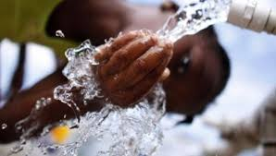
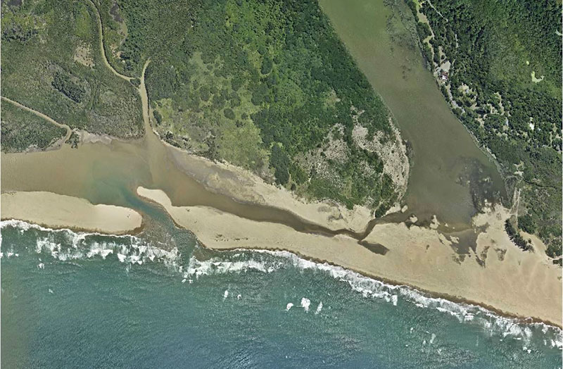
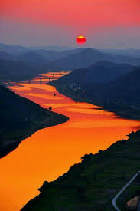
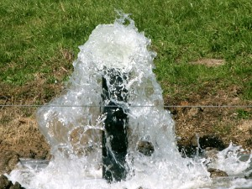
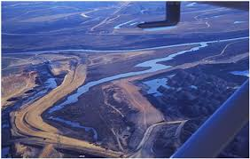
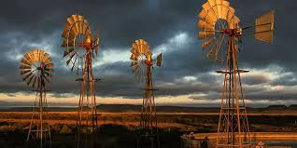
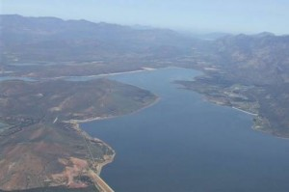
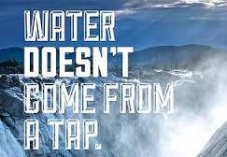

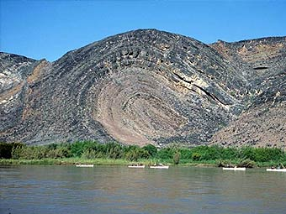

THANK YOU!
Estuaries
Rivers
Groundwater
Wetlands
Dams

